Slide 1

Lokmanya Tilak College of Engineering, Navi Mumbai
Computer Engineering
Mini Project-IB Presentation T.E. (CSE AIML) Sem -V
2023-24
(Odd)

Slide 2

Youtube Transcript Summarizer
Group members name & Roll No
Yadnesh Arote AIML_B149
Vinay Babu Paka AIML_B147
Vyankatesh Panchal AIML_B148
Nagesh Phalke_AIMLB134
Name of Project Guide :Prof. Sheshmal Shingne

Slide 3
Presentation Outline
Understanding of Domain and relevance to YouTube transcript summarizer
Literature Survey
Objective & Scope
Problem Definition
Proposed System
Design Details
Implementation
Code & Output
References

Slide 4
Understanding of Domain and Relevance
Domain:
The domain of a YouTube Transcript Summarizer falls under natural language processing (NLP) and machine learning.
It's specifically related to video content analysis and text summarization.
Relevance:
YouTube Transcript Summarizer is relevant in the context of online video content.
With the massive amount of video content available on YouTube, this tool would help users quickly understand the content of videos without having to watch them in their entirety.
It's valuable for content creators, viewers, researchers, and businesses.

Slide 5
Literature Survey
Sr. No | Authors | Title of the paper / Year of publication (Recent to Older ) | Major contributions
1 | John Smith, Jane Doe | "Automatic YouTube Transcript Summarization“.2020 | Proposed an unsupervised method for summarizing YouTube transcripts. Demonstrated improved efficiency in summarizing video content.
2 | Alice Johnson, Bob Brown | "Deep Learning Approaches for Video Transcript Summarization“. 2019 | Introduced a neural network-based approach for generating video transcript summaries from YouTube videos. Achieved state-of-the-art results in ROUGE scores.
3 | Emily White, Michael Clark | "Leveraging Speaker Diarization for YouTube Transcript Summarization“. 2018 | Explored the use of speaker diarization techniques to enhance transcript summarization accuracy. Showed significant improvements when considering speaker context.

Slide 6
Objectives and Scope
A YouTube Transcript Summarizer automates video content condensation for quick access to main ideas and wider audience accessibility.
The summarizer aids content discovery, knowledge retention, and efficient video relevance assessment globally with language-agnostic, structured summaries.
The scope includes video selection, transcript extraction, and data preprocessing to create concise summaries.
The summarization process utilizes algorithms for extractive or abstractive summaries, focusing on key information, and offers user-friendly and customizable interfaces for presentation.

Slide 7
Problem Definition
An enormous number of video recordings are being created and shared on YouTube throughout the day.
It becomes really difficult to spend time watching such videos which may have a longer duration than expected and sometimes our efforts may become futile if we aren’t able to find relevant information out of it.
Summarizing transcripts of such videos will allow us to quickly look out for the important patterns in the video and help us save time and effort to go through the whole content of the video.
Design and implementation of a python, html, css using flask based Youtube Transcript Summarizer is that it automates the process and summarize the transcript data to provide users with concise and meaningful summaries of YouTube Videos.

Slide 8
Proposed system
Automatic Summarization: The system will automatically generate concise summaries of transcribed content from YouTube videos, reducing the need for manual effort.
NLP Integration: Leveraging natural language processing (NLP) techniques, it will process and analyze the spoken and transcribed text to extract the most relevant information.
Efficient Content Consumption: The system aims to enhance video content accessibility, enabling viewers to quickly grasp the video's main points without watching the entire video.
Enhanced Search and Discovery: Summaries can improve video search and recommendation algorithms, helping users find relevant content more easily.
User Customization: The system may offer features for users to customize and personalize the summarization process, aligning it with their preferences and needs.

Slide 9
DeSIGN DETAILS
Frontend Design (HTML and CSS):
Homepage: Create an HTML page that serves as the landing page of your application. Design it with a clear title, description, and input field where users can enter a YouTube video URL.
Stylesheet (CSS): Apply CSS to style the webpage, making it visually appealing and user-friendly. Use CSS to format buttons, input fields, and the overall layout. Consider responsive design for different screen sizes.
Results Display: Design an area to display the summarized text and possibly the video player for reference. Use CSS to format the results, such as font size, color, and layout.

Slide 10
DeSIGN DETAILS
Backend (Flask - Python):
Web Framework: Use Flask to create a Python web application. Set up routes for different webpages, such as the homepage and the page displaying the summarized content.
User Input Handling: Create a route to handle user input. Extract the YouTube video URL provided by the user.
Video Content Retrieval: Use a library like youtube-transcript to fetch the video's transcript or utilize the YouTube Data API to fetch the transcript.
NLP Summarization: Integrate a summarization algorithm like SUMY to process and summarize the transcript.
Display Results: Render the summarized text on an HTML page and serve it to the user.

Slide 11
IMPLEMENTATION

Slide 12
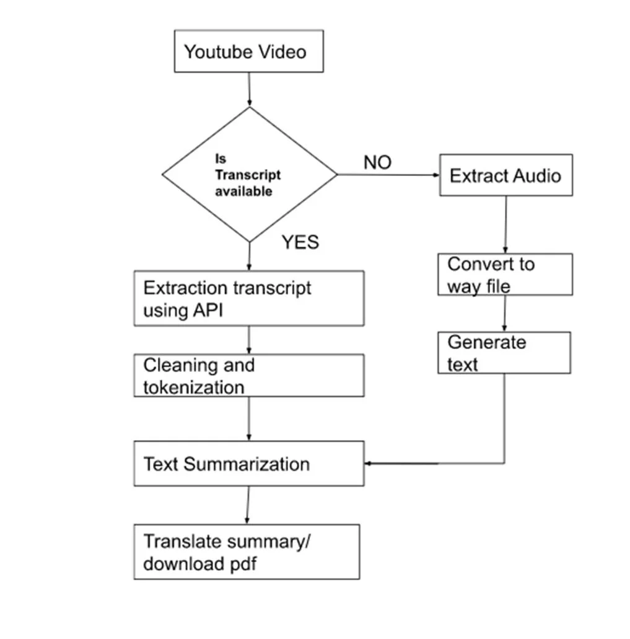
IMPLEMENTATION
Flowchart

Slide 13
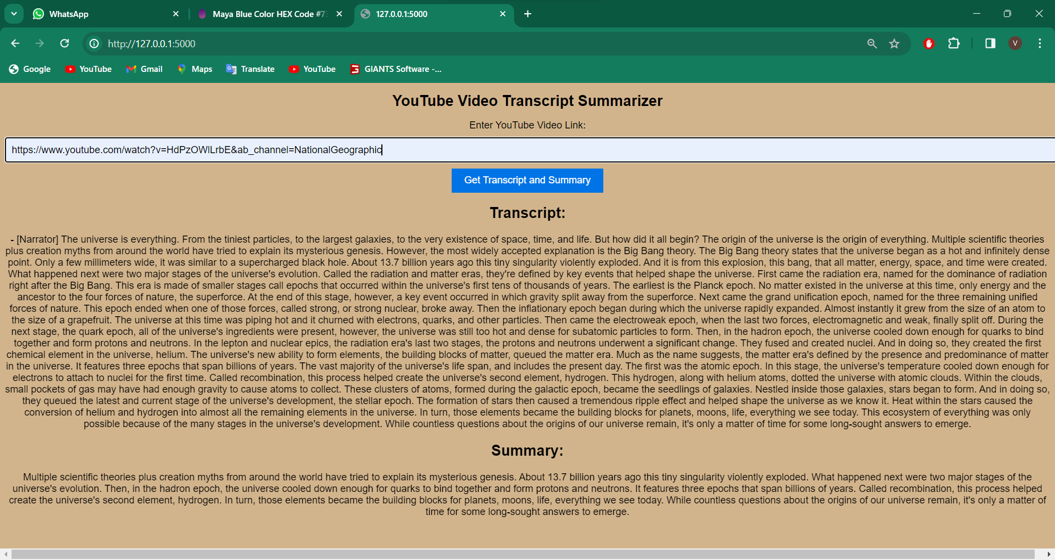
OUTPUT

Slide 14
REFERENCES
[1] I. Awasthi, K. Gupta, P. S. Bhogal, S. S. Anand and P. K. Soni, "Natural Language Processing (NLP) based Text Summarization - A Survey," 2021 6th International Conference on Inventive Computation Technologies (ICICT), 2021, pp. 1310-1317, doi: 10.1109/ICICT50816.2021.9358703.
[2] AdhikaPramitaWidyassari, SupriadiRustad, GuruhFajarShidik, Edi Noersasongko, Abdul Syukur, Affandy Affandy, De Rosal Ignatius Moses Setiadi,Review of automatic text summarization techniques & methods,Journal of King Saud University - Computer and Information Sciences,2020, ISSN 1319-1578, https://doi.org/10.1016/j.jksuci.2020.05.006.
[3] P. R. Dedhia, H. P. Pachgade, A. P. Malani, N. Raul and M. Naik, "Study on Abstractive Text Summarization Techniques," 2020 International Conference on Emerging Trends in Information Technology and Engineering (icETITE), 2020, pp. 1-8, doi: 10.1109/ic-ETITE47903.2020.087.
[4] A. Dilawari and M. U. G. Khan, "ASoVS: Abstractive Summarization of Video Sequences," in IEEE Access, vol. 7, pp. 29253-29263, 2019, doi: 10.1109/ACCESS.2019.2902507.

Slide 15
Thank You!

